Slide 1

Chapter One (b)
CIS 201 - Fundamentals of Web Design
Software Engineering Department
College of Engineering and Architecture
Al Yamamah University
The Web Programmer’s Toolbox
Instructor: Layla Albabtain Spring 2019

Slide 2
Web Development Tools
What do you think the tools used to design and develop web pages?!
What do you think the tools used to design and develop web pages?!
The Most common tools are:
HTML / XHTML. (structure)
CSS. (presentation)
Javascript. (interactivity and dynamic content) (front end)
C# (can be used in place of javascript)
Java (can be used in place of javascript)
Flash (actionscript).
Very similar to javascript.
XML
To copy information between different application.
Ajax.
Reduce loading time between pages.
ASP.NET.
Framework by MS used to develop webpages.
PHP and Ruby.
Server side creating. (back end)
C# (can be used in place of php)
Java (can be used in place of php)
JS (is reraly used in back end development)

Slide 3
Web Development Tools
Some of these tools are programming languages some are not.
HTML, XHTML and XML are not programming languages.
They cannot be used to describe computations.
JavaScript, PHP, and Ruby are programming languages.
ASP.NET, and Rails are development frameworks for Web-based systems.
Flash is a technology for creating and displaying graphics and animation in XHTML documents.
Ajax is a Web technology that uses JavaScript and XML

Slide 4
HTML
HyperText Markup Language (HTML) is the standard markup language for creating web pages and web application.
The word markup comes from the publishing world.
where it is used to describe what production people do with a manuscript to specify to a printer how the text, graphics, and other elements in the book should appear in printed form
An HTML document is a mixture of content and controls.
The controls are specified by the tags of HTML.
The name of a tag specifies the category of its content.
Most HTML tags consist of a pair of syntactic markers that are used to delimit particular kinds of content.
E.g: <tag> content </tag>

Slide 5
MyFirstPage.html
Create an html document, with the name: MyFirstPage.
Add the following tags:
<html>
<body>
This text is not between tags.
This text is also not between tags.
<h1> This text is between a header tag </h1>
<p> This text is between a paragraph tag </p>
</body>
</html>

Slide 6
HTML Document Creation Tools
HTML documents can be created with a general-purpose text editor.
There are two kinds of tools that can simplify this task:
HTML editors. E.g Notepad++
what-you-see-is-what-you-get (WYSIWYG, pronounced wizzy-wig) HTML editors. E.g: Google Sites.
HTML editors provide shortcuts for producing repetitious tags such as those used to create the rows of a table.
They also may provide a spell-checker and a syntax-checker, and they may color code the HTML in the display to make it easier to read and edit.
Note: In this course we will use Notepad++, you are free to choose any other editor you feel comfortable with.

Slide 7
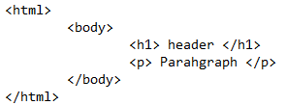
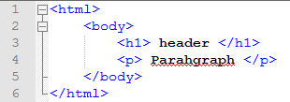
Notepad Vs Notepad++

Slide 8
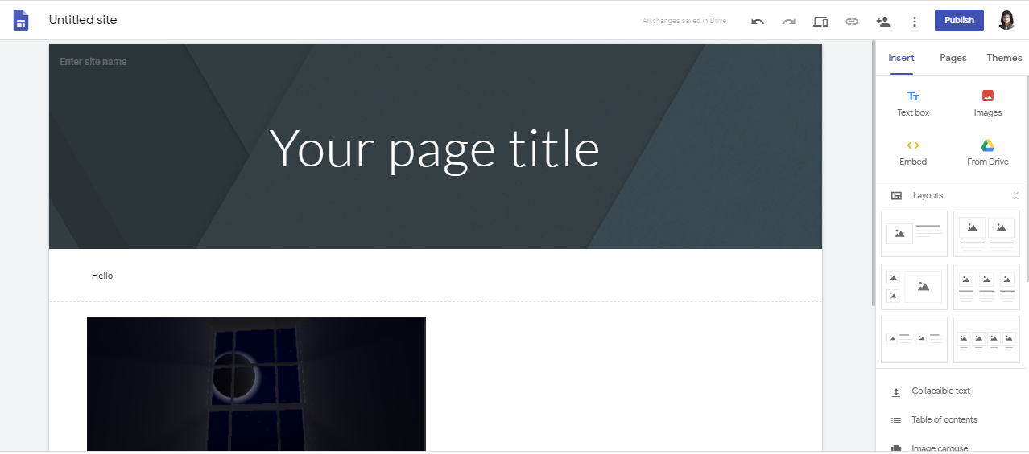
WYSIWYG Editor

Slide 9

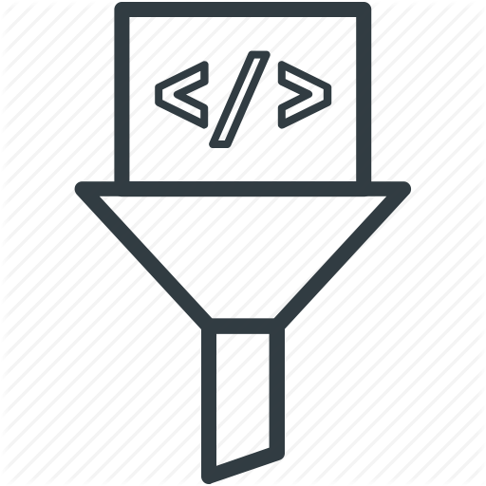
Plug-ins and Filters
Two different kinds of converters can be used to create XHTML documents.
Plug-ins.
Filters.

Slide 10
Plug-in
Plug-ins are programs that can be integrated together with a word processor.
Plug-ins add new capabilities to the word processor.
such as toolbar buttons and menu elements
Plug-ins provide convenient ways to insert HTML into the document being created or edited.
The plug-in makes the word processor appear to be an HTML editor that provides WYSIWYG XHTML document development.
The end result of this process is an HTML document.
The plug-in also makes available all the tools that are inherent in the word processor during HTML document creation
such as a spell-checker.

Slide 11
Filters
Filters converts an existing document in some form, such as LaTeX or Microsoft Word, to HTML.
Filters are never part of the editor or word processor that created the document.
This is an advantage because the filter can then be platform independent.
For example, a Wordperfect user working on a Mac computer can use a filter running on a UNIX platform to provide documents that can be later converted to HTML.
The disadvantage of filters is that creating HTML documents with a filter is a two-step process:
First you create the document
Then you use a filter to convert it to XHTML

Slide 12

Plug-ins and Filters
Advantages:
The two advantages of both plugins and filters, are:
Existing documents produced with word processors can be easily converted to XHTML
Users can use a word processor with which they are familiar to produce HTML documents.
This obviates the need to learn to format text by using HTML directly.
For example, once you learn to create tables with your word processor, it is easier to use that process than to learn to define tables directly in HTML.

Slide 13

Plug-ins and Filters
Disadvantages:
The HTML output produced by either filters or plug-ins often must be modified, usually with a simple text editor, to perfect the appearance of the displayed document in the browser.
Because this new XHTML file cannot be converted to its original form (regardless of how it was created).
This leads to: having two different source files for a document, inevitably leading to version problems during maintenance of the document.

Slide 14
XML
HTML is defined with the use of the Standard Generalized Markup Language
(SGML), which is a language for defining markup languages.
Such languages are called meta-markup languages.
XML (eXtensible Markup Language) is a simplified version of SGML, designed to allow users to easily create markup languages that fit their own needs.
XHTML is defined with the use of XML.
Whereas XHTML users must use the predefined set of tags and attributes,
when a user creates his or her own markup language with XML, the set of tags and attributes is designed for the application at hand.

Slide 15
XML and HTML
XML was designed to carry data - with focus on what data is
HTML was designed to display data - with focus on how data looks
XML tags are not predefined like HTML tags are.
In many HTML applications:
XML is used to store or transport data.
While HTML is used to format and display the same data.
Note: XML will not be covered in this course. However, it is check. For more information check this link.

Slide 16
CSS
CSS stands for Cascading Style Sheets.
CSS describes how HTML elements are to be displayed on screen, paper, or in other media.
We will learn more about CSS later.
For more on CSS check this link.

Slide 17
JavaScript
JavaScript is a client-side scripting language whose primary uses in Web programming are to validate form data and to create dynamic HTML documents.
Javascript is note Java!!
JavaScript “programs” are usually embedded in HTML documents.
These documents are downloaded from a Web server when they are requested by browsers.
The JavaScript code in an HTML document is interpreted by an interpreter embedded in the browser on the client.
One of the most important applications of JavaScript is to dynamically create and modify documents.

Slide 18
Example of JavaScript - Changing HTML Elements
In the Editor create a new html document and name it: MyFirstJavaScript.html.
Write the following in the document:
<html>
<body>
<p id="demo">.....</p>
<button onClick="PrintDate()"> Print Date </button>
<script>
function PrintDate(){
document.getElementById('demo').innerHTML = Date();
}
</script>
</body>
</html>

Slide 19
Example of JavaScript - Changing Elements Style
In the Editor create a new html document and name it: MySecondJavaScript.html.
Write the following in the document:
<html>
<body>
<p id="p1">Hello World!</p>
<p id="p2">Hello World!</p>
<button onClick="changeStyle()"> Change Style </button>
<script>
function changeStyle(){
document.getElementById("p2").style.color = "blue";
}
</script>
<p>The paragraph above was changed by a script.</p>
</body>
</html>

Slide 20
PHP
PHP is a server-side scripting language specifically designed for Web applications.
PHP code is embedded in HTML documents, as is the case with JavaScript.
With PHP, however, the code is interpreted on the server before the HTML document is delivered to the requesting client.
A requested document that includes PHP code is preprocessed to interpret the PHP code and insert its output into the HTML document.
The browser never sees the embedded PHP code and is not aware that a requested document originally included such code.

Slide 21
PHP
PHP is similar to JavaScript, both in terms of its:
Syntactic appearance
And in terms of the dynamic nature of its strings and arrays.
PHP files, in order to work, the file must have php as extension.
Javascript can work in both .html and .js files.
PHP files works only when:
A server is set up (E.g Apache).
The file is placed in the a root document.
JavaScript file can work by just opening it in a web-browser.
Note: PHP is not covered in this course, it will be covered in the SWE322 Advanced Web Programming course.

Slide 22
PHP Code Example
<html>
<body>
<?php
Function printName($x){
echo “Hello”.$x;
}
printName(“Najla”);
?>
</body>
</html>

Slide 23
Homework
The total grade of this homework is: 5 marks.
In the editor create an html document and name it: yourname_homework01.html.
In the html document write:
A header: “Your full name”.
A paragraph: “Talk about yourself, who you are, what do you like, what do you wish to achieve etc.”
Bonus (1 mark)
Check w3school website on how to do list and add a list of your achievements.
Compress it as zip and Submit in LMS by next lecture.

Slide 24
Resources
Programming the World Wide Web - Pearson. Chapter 1.
W3 School.

